Slide 1
2024 REPORT OF THE CHHA BC PROGRAM COORDINATOR

Slide 2
CONTENT
01
INTRODUCTION
02
EVENTS 2023
03
EVENTS 2024
04
ACKNOWLEDGMENT
05
CONCLUSION

Slide 3
MISSION
To create a supportive and empowering environment for hard-of-hearing youth and children. Through a series of engaging activities and events, the program aims to promote hearing awareness and enhance social interactions, friendships, and overall well-being while fostering personal and career growth.
By providing opportunities for connection, resilience-building, and skill development, the project endeavours to empower hard-of-hearing individuals to navigate both their personal and professional lives with confidence and success.

Slide 4
OBJECTIVES
·Enhance Social Interaction and Friendship
·Provide opportunities for hard-of-hearing youth to interact with peers in a comfortable and inclusive environment.
·Boost Self-Confidence
·Offer activities where hard-of-hearing youth can express themselves and showcase their abilities.
·Raise awareness and understanding of hearing loss among participants and their families.
·Provide resources and information about hearing health and coping strategies.
·Provide opportunities for families to connect and share experiences.
·Offer workshops or discussions on topics relevant to the experiences and challenges of hard-of-hearing youth.

Slide 5
EVENTS 2023
CHHA BC Chapter's Escape Room Fiesta: A Night of Adventure and Inclusion
CUSTOMERS

Slide 6
EVENTS 2023
Participation at SayWhat Club Convention 2023

Slide 7
EVENTS 2023
Family Weekend Camp September 2023

Slide 8
EVENTS 2023
Art Themed Holiday Party

Slide 9
EVENTS 2024
Panel Discussion
Beyond Silence: A Dialogue on Hard of Hearing Experienc

Slide 10
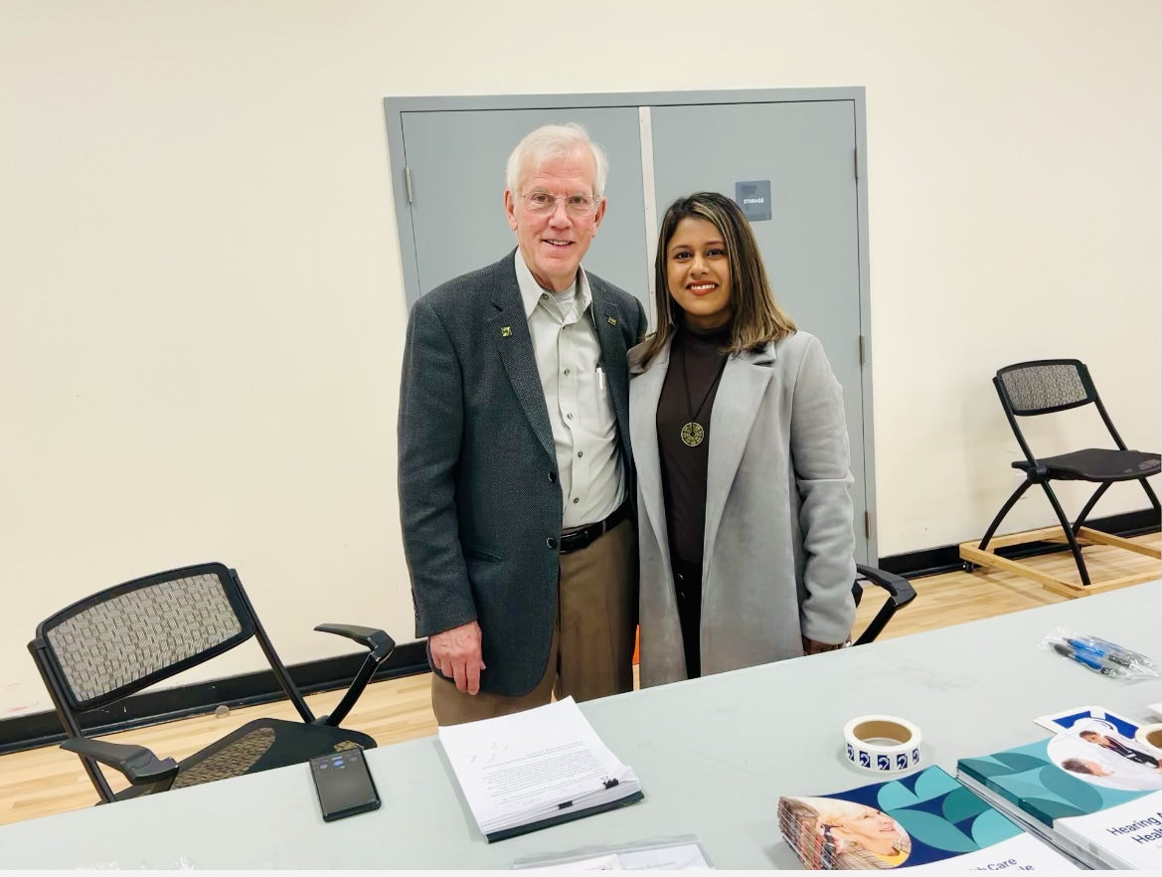
EVENTS 2024
IMPAIRMENTS OPEN HOUSE event participation: CHHA BC Advocacy: Promoting Awareness

Slide 11
EVENTS 2024
The Way, We Hear It! A Community Engagement Exhibition 2024

Slide 12
EVENTS 2024
The Way, Family Weekend Camp 2024, September

Slide 13
EVENTS 2024
Family picnic in July
Hike/Trail
Pumpkin Patch in October
Christmas Party in December

Slide 14
Volunteers
Project Innovations 2025

Slide 15
ACKNOWLEDGEMENTS
CHHA BC Board.
CHHA BC Staff
Federal Government
BC Gaming Grant
Caldor Foundation
CHHA Vancouver Foundation

Slide 16
THANK YOU

